Slide 1
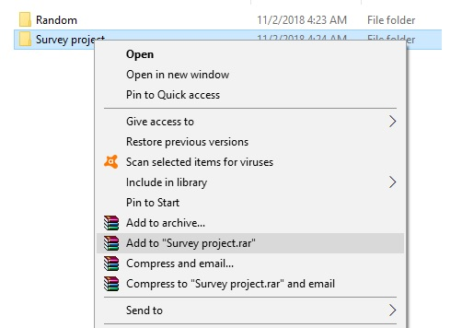


Please make a copy!
File -> Make a Copy
Remember to include your workbook and this presentation in your submission!

Slide 2
Histogram the average number of hours of sleep students
<visualization or summary statistics used for finding>
Here are histogram the average number of hours of sleep students
Through the visual I show most students sleep between 6 to 8 hours and the drawing shows that there is symmetric in the data and that Mean, Mode Median is equals This explains frequently normally distributed. This diagram represents the shape of the bell

Slide 3
Column Chart Find Udacity
<visualization or summary statistics used for finding>
Here are column chart How Find Udacity Students.
Through the survey analysis of Udacity students show how they got to this beautiful educational site that the Google site has The largest share as well as communication with friends, but we find that there are other means of communication did not mention in the Survey data was 14 percent may be other means

Slide 4
Scatter chart relationship between age years and years of experience.
<visualization or summary statistics used for finding>
Here are scatter chart relationship between age years and years of experience in the Survey data.
Direction positively correlated, form liner, relationship strong noted through the Survey we note that the greater the age of the student increased experience with him and here a strong relationship between them

Slide 5
Pie chart for most common countries/cities where students live
<visualization or summary statistics used for finding>
Here ara Pie chart for most common countries/cities where students live
Through visualization for the place where students live, the largest country came to Argentina, followed by Russia and Canada at the last level.

Slide 6
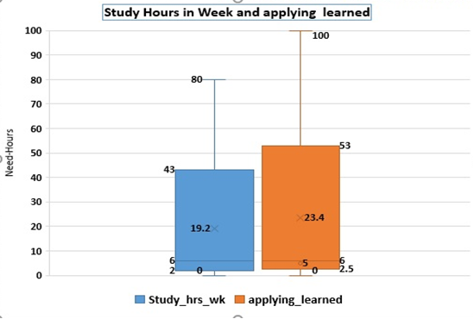
Box plot for many hours per week do students spend content and applying what you learned.
<visualization or summary statistics used for finding>
Here are Box plot for many hours per week do students spend content and applying what you learned.
Noted in the visualization box plot is skewed to the right the mean greater the median positively skewed lots of the data observation to the left we can see now the distance between the median and the upper quartile is greater than median in the lower quartile

